Slide 2
Real Time Loyalty Management
Presented By:
R172218031 500067557 Ayush Gupta
R172218138 500068557 Anusha Goel
R172218014 500067702 Anamol Verma
R172218146 500070378 Aryan Arora
Under The Guidance Of:
Dr. Hitesh Kumar Sharma
School Of Computer Science

Slide 3
Table Of Contents
Objective
What’s New
Target Audience
Technology Used
Project Demonstration
Future Scope
Conclusion

Slide 4
Objective
Real time transactional data will be generated in SFDC.
This real time data needs to be processed against a calculation engine.
The data generated after processing the data will be credited into the customer’s account, in the form of loyalty points.

Slide 5
What’s New?
Distribution of the loyalty points by processing details of the customer.
It uses the customer-provided data to present customers with loyalty points which enables them to purchase more.
The more often a customer patronizes the merchant—and the more they spend—the greater their points.

Slide 6
Target Audience
Our project is intended for customers which deals with purchasing of products in day-to-day life.
It focuses on companies across industries, including retail, consumer goods, manufacturing, to increase customer trust and engagement.
It focuses on the customers who are interested in making additional purchases to get more rewards so they can get high discounts.

Slide 7
Technology Used
Salesforce:
It is a customer relationship Management platform (CRM), the most important tool in effective loyalty management.
Loyalty Management is built on the Salesforce platform so businesses can design a variety of different programs that meet their unique needs.
It gives companies a 360-degree view of every member to increase customer satisfaction and create revenue-generating loyalty programs.

Slide 8
It consists of 3 things:
A single view of the customer: the ability to understand who the customer is, across all touchpoints
Personalization: enabling one-to-one engagement across any channel and across every step in the shopper’s path to purchase, and then beyond — after all, customer service is an essential factor in encouraging customers to return.
Proactivity: driving engagement with predictive analytics and recommendations. 57% of consumers agree they’re willing to share data with companies that send personalized offers and discounts.

Slide 9
Project Demonstration
Create an application
Create an application named “Loyalty Management”. This is where the all fields and objects will be created.
To create an application : Setup->Build->Create->App
Create object
Create object named “Customer details”. Inside this object will be our fields and records.
Object is created by : Setup->Build->Create->Objects
Create Custom fields and relationships
To create fields, go to Objects->Customer details->New field. We can also define any dependencies between the fields under the “field dependencies” option.

Slide 10
Project Demonstration
We defined 15 fields according to our data set. The fields are:
S.no, Invoice id, Branch, City, Product unit, Unit price, Quantity, Tax, Total Price, Date, Time, Payment, Cogs, Phone number, Loyalty points.
Upload the data set
Calculate loyalty points

Slide 11
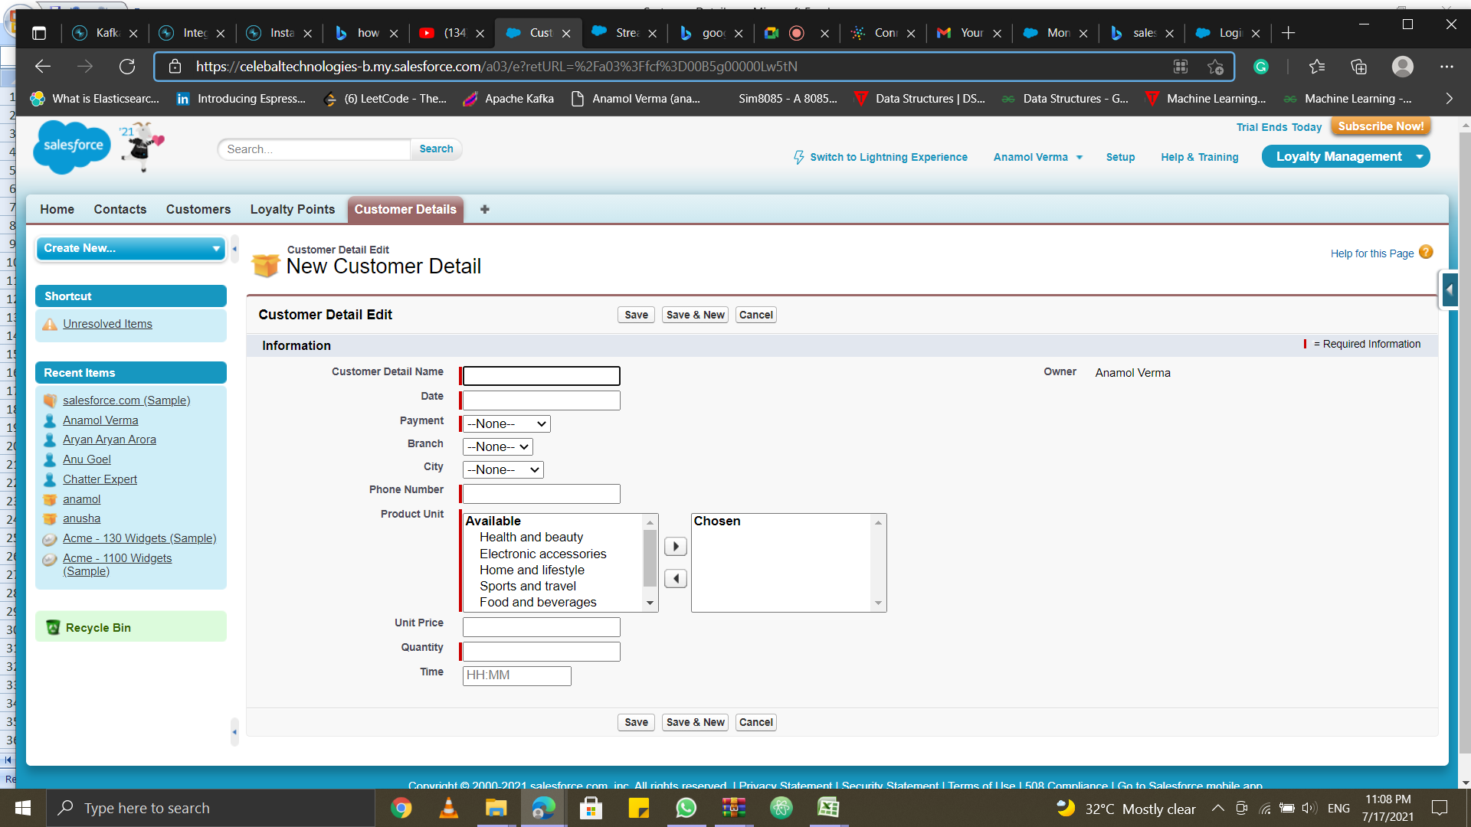
Fig 1: It depicts the entries of the new customer

Slide 12
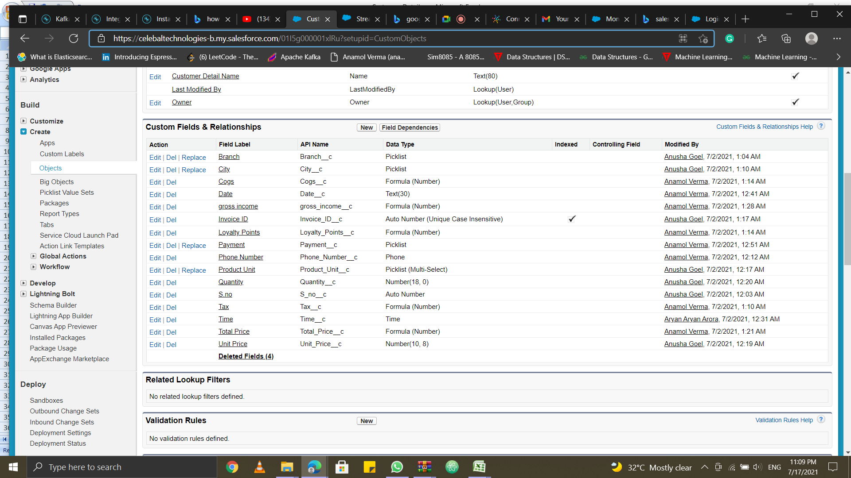
Fig 2: It represents various fields and relationships under loyalty management system

Slide 13
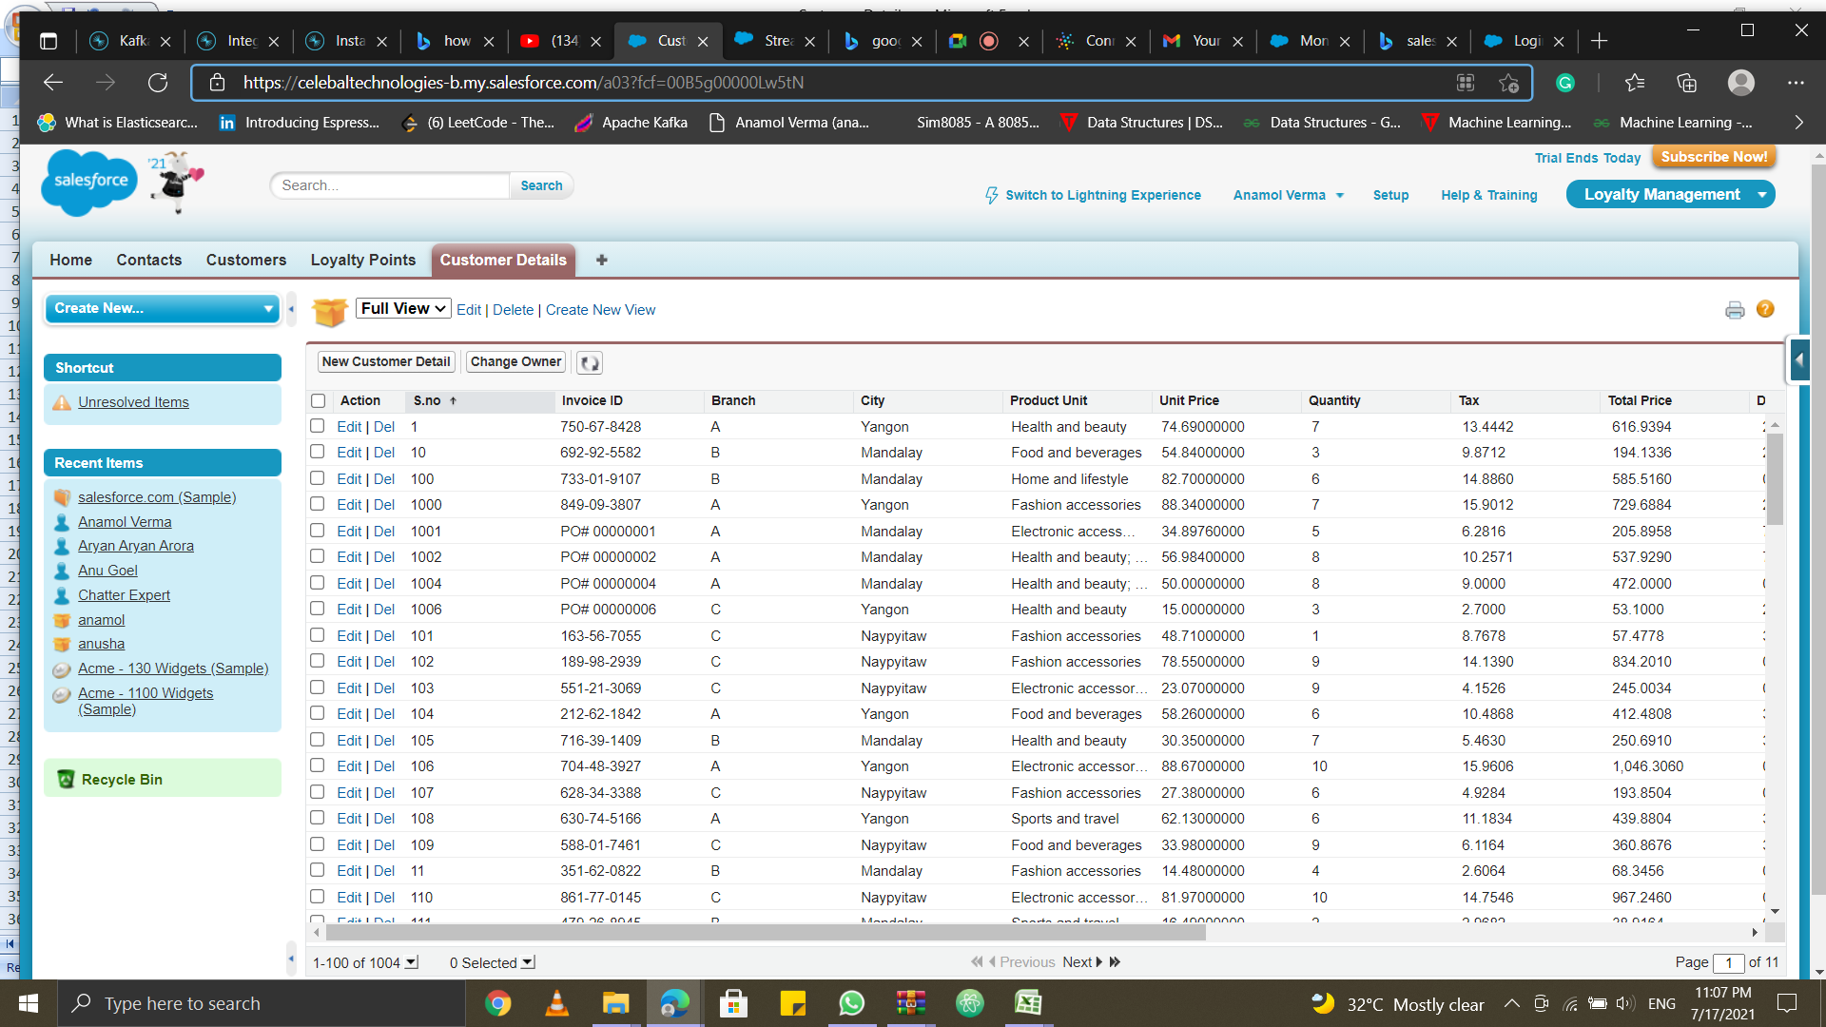
Loyalty management system was build successfully
Fig 3(a): It shows all the details of various customers in the system

Slide 14
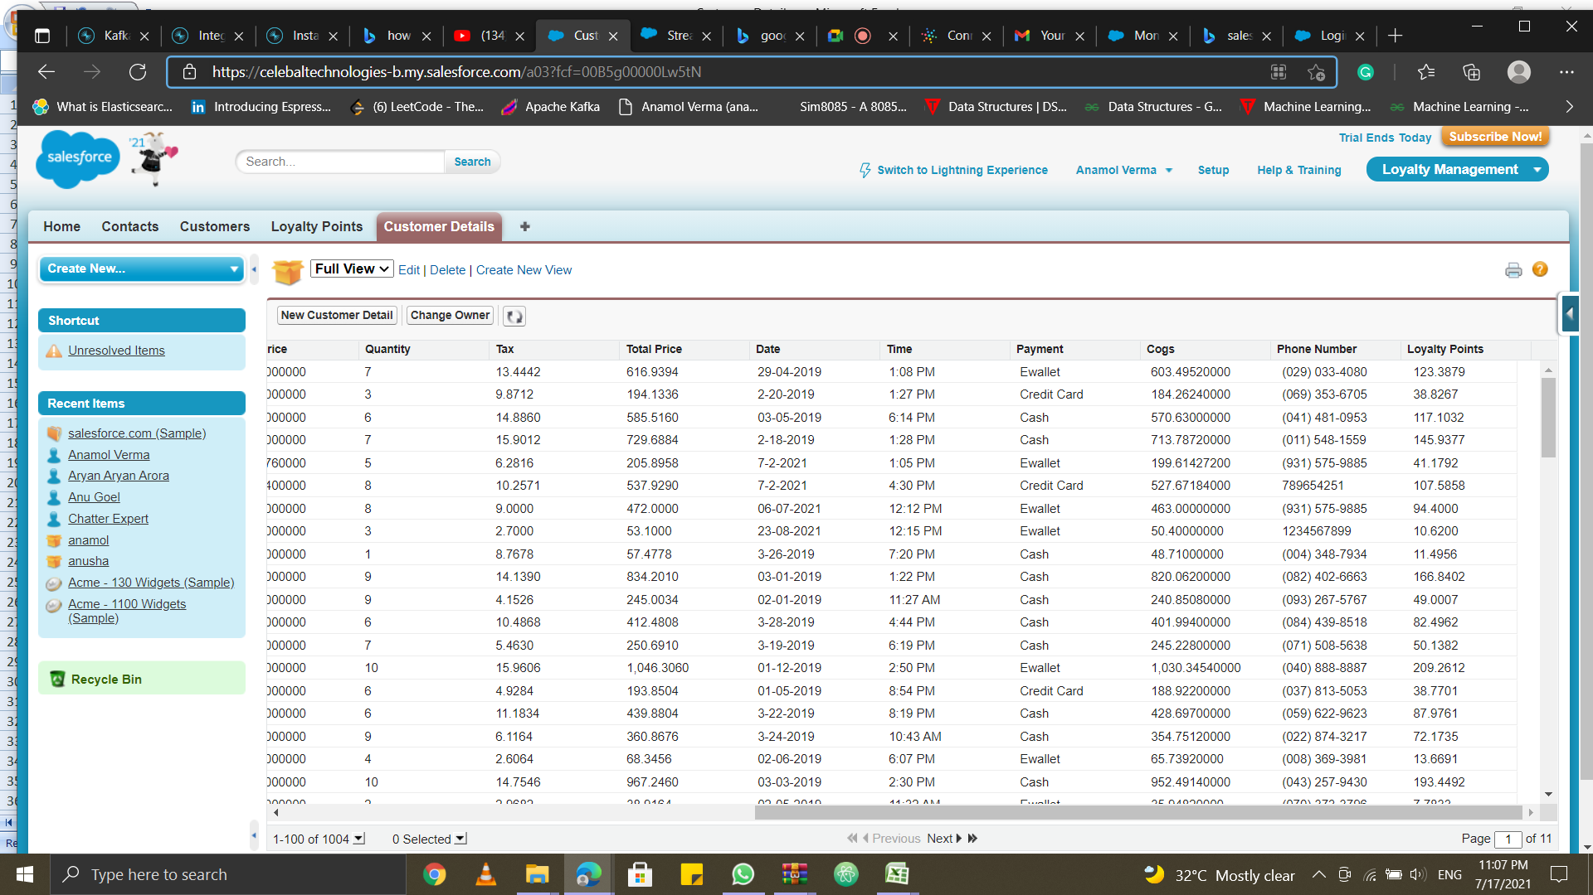
Fig 3(b): It represents the loyalty points assigned to each customer according to their purchase

Slide 15
Future Scope
It can be used for more analysis (such as how many did payment by E-wallet)
It can provide better customer relation management.
It can also be integrated with Kafka using Salesforce Streaming API.
More insights can be drawn from the table.

Slide 16
Conclusion
Loyalty management system was build successfully.
Loyalty points are assigned according to the customer purchases.

